Slide 1
Variations on k-Nearest Neighbors Algorithms
Logan Ladd and Asher Worley

Slide 2
Problem Statement
We hypothesise that a basic k-nearest neighbor model will generally perform better than any of the pared models examined.

Slide 3
Models
Categorical Classification:
K-nearest neighbors
Edited k-nearest neighbors
Condensed k-nearest neighbors
Regression Classification:
K-nearest neighbors
K-means clustering
K-medoids clustering

Slide 4
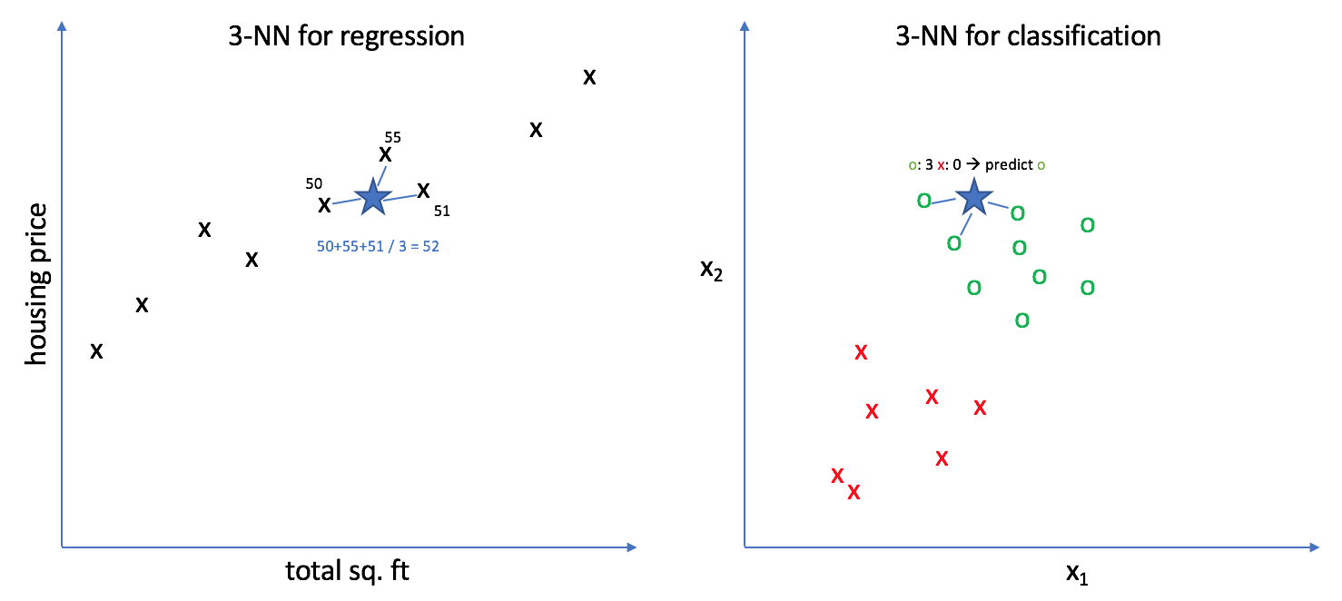
K-Nearest Neighbors

Slide 5
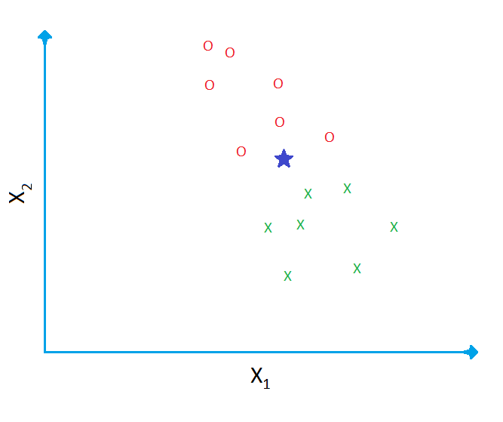
Edited k-Nearest Neighbors

Slide 6
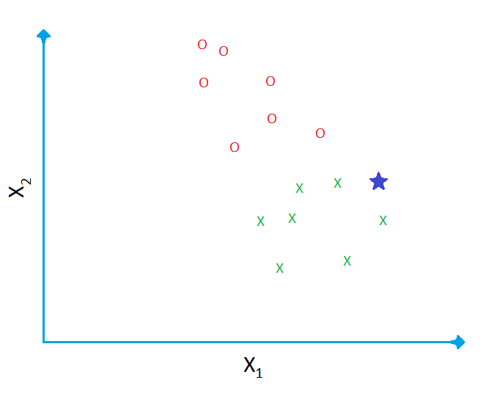
Condensed k-Nearest Neighbor

Slide 7
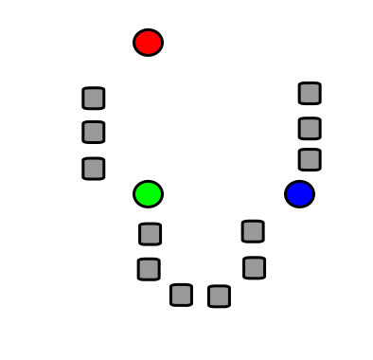
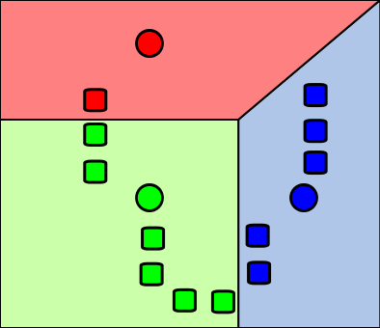
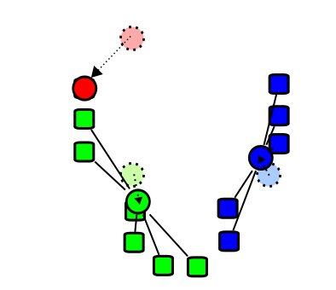
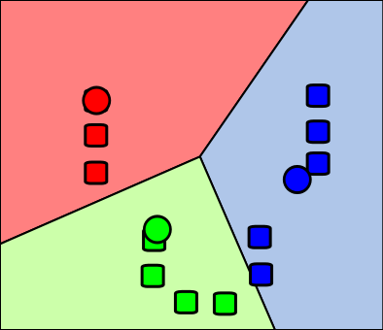
K-Means Clustering

Slide 8
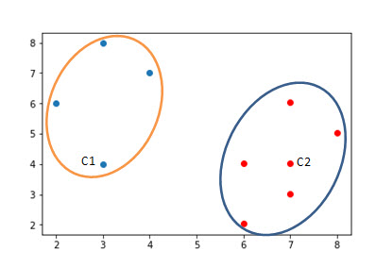
K-Medoids Clustering

Slide 9
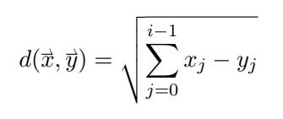
Metric Space: Euclidean

Slide 10
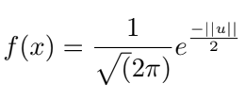
Gaussian Kernel

Slide 11
Code
You will want to cut from here to the code. Be sure to show the preprocessing, including the ten-fold cross-validation process. Show the code for all the models.

Slide 12
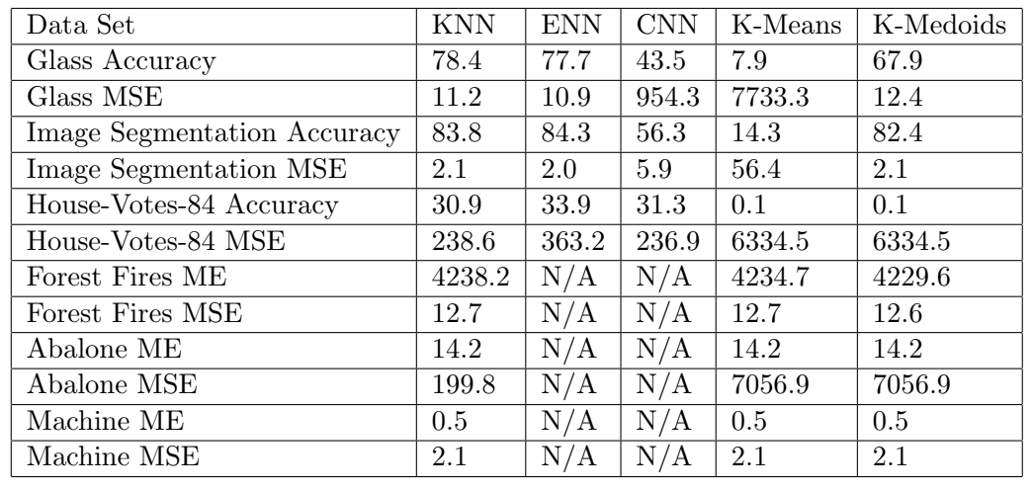
Results

